Slide 1
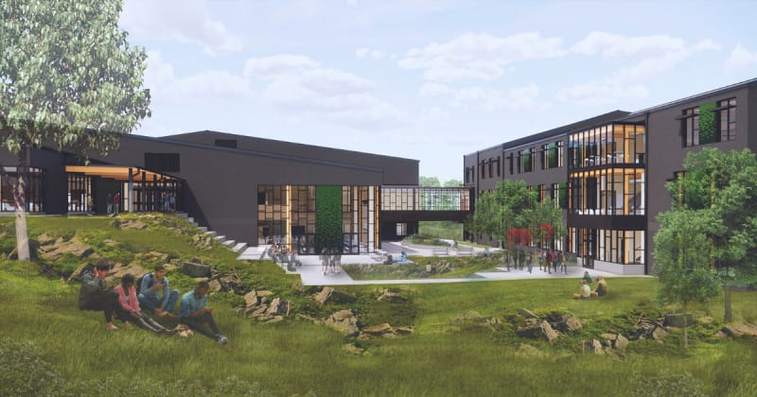
Evergreen coordination
Demo 3 · Reviewing construction requests
INFO 492 Team 2 Anthony Faldetta, Cole Wieland, Crystal Doan Tran, Haohao Li
Notes:
• Our thesis asks whether AI can help teams resolve more questions from the records they already have.
• Evergreen High School’s floor remediation inspired the synthetic coordination cases.
• The 30% goal refers to unnecessary requests for information, or RFIs.
• Image source is the Evergreen project rendering already credited on the Team 2 site.

Slide 2
What Demos 1 and 2 established
Demo 1 · Meeting notes
Demo 2 · Daily report review
54.1%
12 of 12
Less time to prepare drafts
27m 31s AI · 60m manual
Issue categories flagged by AI
Human reviewers found 11 and 7
88% draft accuracy
92% manual accuracy
3m 29s AI processing
56m average manual review
These experiments measured note preparation and issue review. The thesis measures unnecessary RFIs.
Notes:
• Demo 1 used two simulated meetings. The drafts were quicker to prepare, and some details still needed correction.
• The Demo 2 writeup reports 209 seconds for AI and 3,360 seconds for manual review. The batch-size records disagree, so we cite the reported timings with that caveat.
• The two human Demo 2 reviewers found 11 and 7 of the 12 expected issue categories.
• These results are from different tasks and setups. We still need to compare RFI decisions directly.
• Sources are the Team 2 Demo 1 and Demo 2 writeups and Mid-Quarter Analysis.

Slide 3
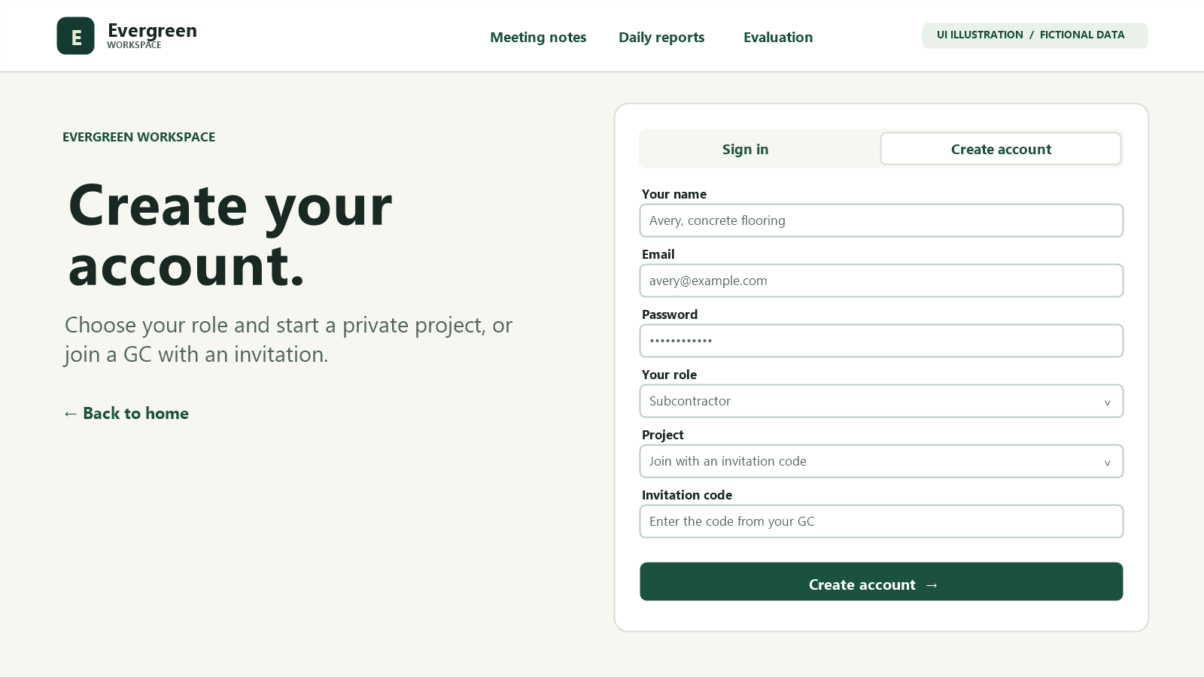
Project access and roles
Subcontractor
Join with an invitation. Choose which review and source records to share with your GC.
General contractor
Create a private project, invite subcontractors and review the runs they share.
Account setup illustration with fictional information.
Access verified locally. Hosted sign-in pending.
Notes:
• Open the client workspace from the Team 2 site and choose the project and role.
• Show the subcontractor’s request view and the general contractor’s project review view.
• Local tests confirmed that only the signed-in contractor and the invited subcontractor can see a run shared between them. An outside project cannot open it.
• Demo 1 and Demo 2 demonstrate two sources of coordination information.

Slide 4
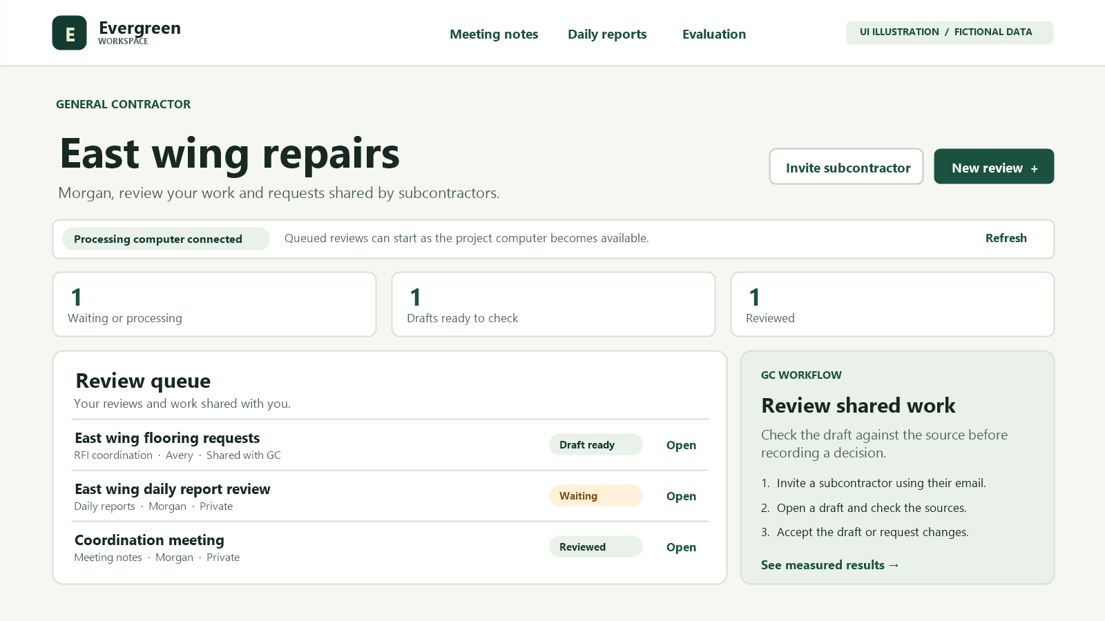
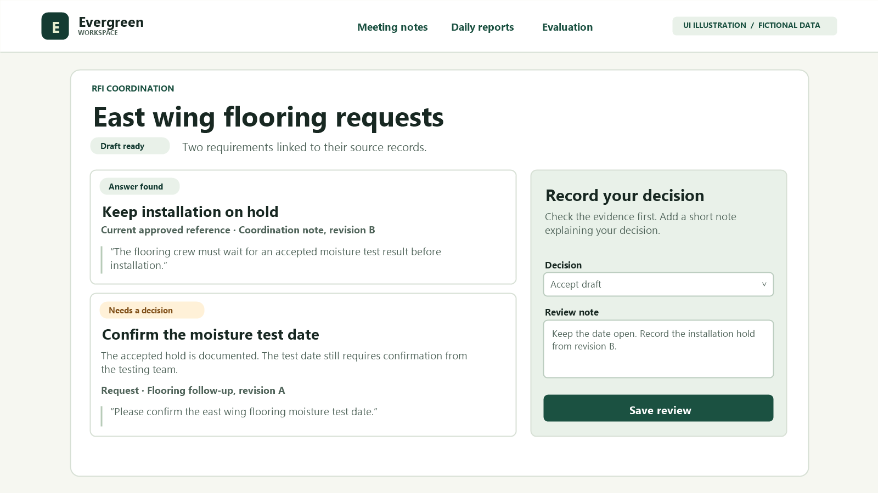
Document review and decisions
Illustrated GC queue with a shared draft.
Illustrated result with source and decision.
Local processing took 67s for RFI, 40s for notes and 183s for reports.
Notes:
• Queue the submitted text while the project computer is offline or busy.
• The model checks the request against source records and tracked work, then returns a proposal.
• Open the exact source text and check its approval and revision before using it.
• A reviewer can approve a task, link a repeat, flag a conflict or keep a question open.
• All three fictional jobs waited while the PC was off, then finished locally. The RFI run returned two tasks in one group with two exact quotes. The other runs returned four draft notes and two draft findings. Times include loading and exclude queue wait and human review.

Slide 5
Demo 3 consolidation results
18/18
18/18
12/12
Development
Former holdout after tuning
Reserved transfer
Synthetic requirements that passed all labeled checks
49.1% less model processing time across five matched cases
Same model and GPU. Human review time remains to be measured.
November 11 retest of the same four transfer cases passed 12/12 in 8m 40s, including loading.
Notes:
• Each requirement check covers the correct action, the correct target and retained detail.
• The former holdout became a regression set once its results informed development.
• V12 transfer cases included two wording issues beyond the labeled checks. No incorrect closures or merges occurred in the scored V12 examples.
• Five matched successful development cases took 49.1% less processing time on the same machine and model. One V1 case failed and is excluded only from the paired timing.
• Model time excludes loading, manual verification and correction in that matched comparison.
• This is a repeat of four known transfer cases. One title said by 15:00 while the full requirement and source retained before 15:00.
• Source is the Demo 3 consolidation benchmark report.

Slide 6
Stakeholder input and next test
Mid-quarter interview
Simulated walkthrough
Trent McMorrow, Cornerstone project engineer, checks whether current drawings or specs already answer a question.
A reviewer links the repeat clearance request, keeps its earlier deadline and leaves the firestop question open.
Next test compares avoidable RFIs and total review time with and without assistance.
Notes:
• In the actual interview, Trent McMorrow described screening questions against drawings and specifications and looking for conflicts earlier.
• He stressed the approval status of project records. Evergreen’s owner barred recording and AI note-taking.
• The clearance and firestop example is a simulated walkthrough. Trent did not try this product version.
• Have two groups work through equivalent unseen cases. Count unnecessary submissions and incorrectly closed questions.
• Time the review and correction work before testing the 30% reduction target.
• Source is the Team 2 Mid-Quarter Analysis interview appendix.

